Slide 1









Sky Forge
COLLEGE NAME: VIT Vellore
INNOHACK ID: INOHAC26000264
HACK ID: DR28

Slide 2
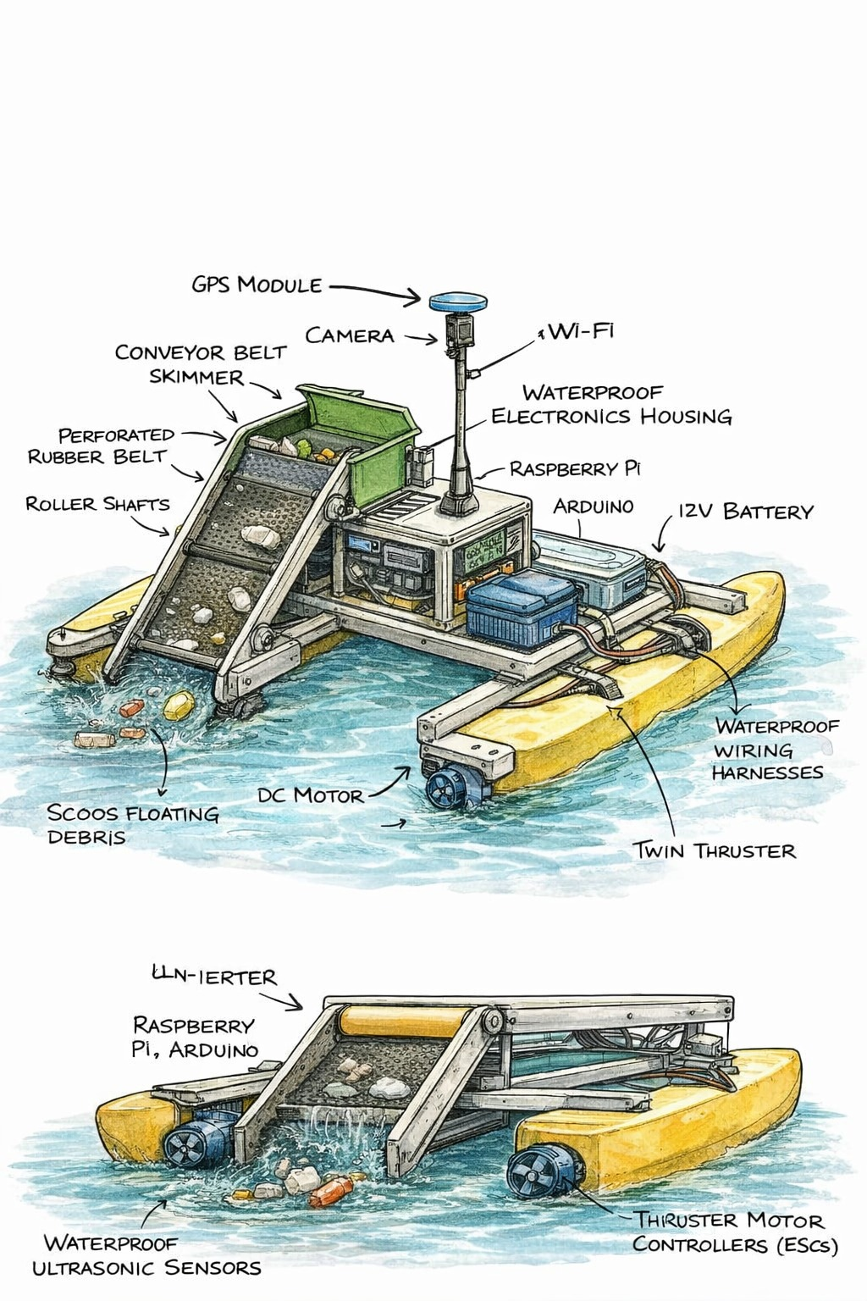
AQUA-SENTINEL:
An Adaptive Autonomous Water Surface Cleaning Robot
Problem Code: PS26
Track: CleanTech / Sustainability

Slide 3
PROBLEM STATEMENT TITLE: An Adaptive Autonomous Water Surface Cleaning Robot
PROBLEM STATEMENT CODE: PS26
TRACK: Drones & Robotics
Problem Explanation:
Floating waste and surface-level pollutants in lakes, rivers, and reservoirs pose severe environmental and public health risks. Existing manual and semi-automated solutions are labor-intensive, unsafe, and non-data-driven.
The Gap:
No adaptive cleaning strategy
No real-time waste density intelligence
No pollution data logging for authorities
Poor coverage efficiency
Existing solutions clean blindly.
They do not think.
Current cleaning methods are:
Manual and labor-intensive
Unsafe for workers
Inefficient for continuous operation

Slide 4

PROPOSED SOLUTION & WORKING
“A software-driven autonomous water surface cleaning robot that dynamically adapts its navigation and collection strategy based on real-time waste density, while generating actionable pollution data.”
Solar-Powered Energy System: A top-mounted solar panel provides auxiliary power and charges the battery, increasing operational duration sustainably.
GPS-Based Navigation: Allows controlled movement, zone-wise cleaning, and geo-tagged pollution mapping.
Camera-Based Waste Detection: A mounted camera identifies floating debris and helps estimate waste density for pollution analysis.
Waste Density & Pollution Data Generation: Sensor and vision data are processed to quantify surface pollution levels.
Twin Thruster Propulsion: Ensures stable movement and precise steering.
IoT Monitoring: Transmits waste density, GPS location, and system status to a remote dashboard.

Slide 5
PROPOSED SOLUTION & WORKING
SYSTEM WORKING (TECHNICAL FLOW)
Robot is deployed in a defined water zone
Ultrasonic + vision sensors scan surface continuously
Waste density is estimated in real time
Navigation algorithm prioritizes high-density zones
Collection mechanism activates only when required
Obstacles and boundaries are avoided autonomously
Data is logged and sent to IoT dashboard
KEY DIFFERENCE:
Not random cleaning Priority-based adaptive cleaning

Slide 6
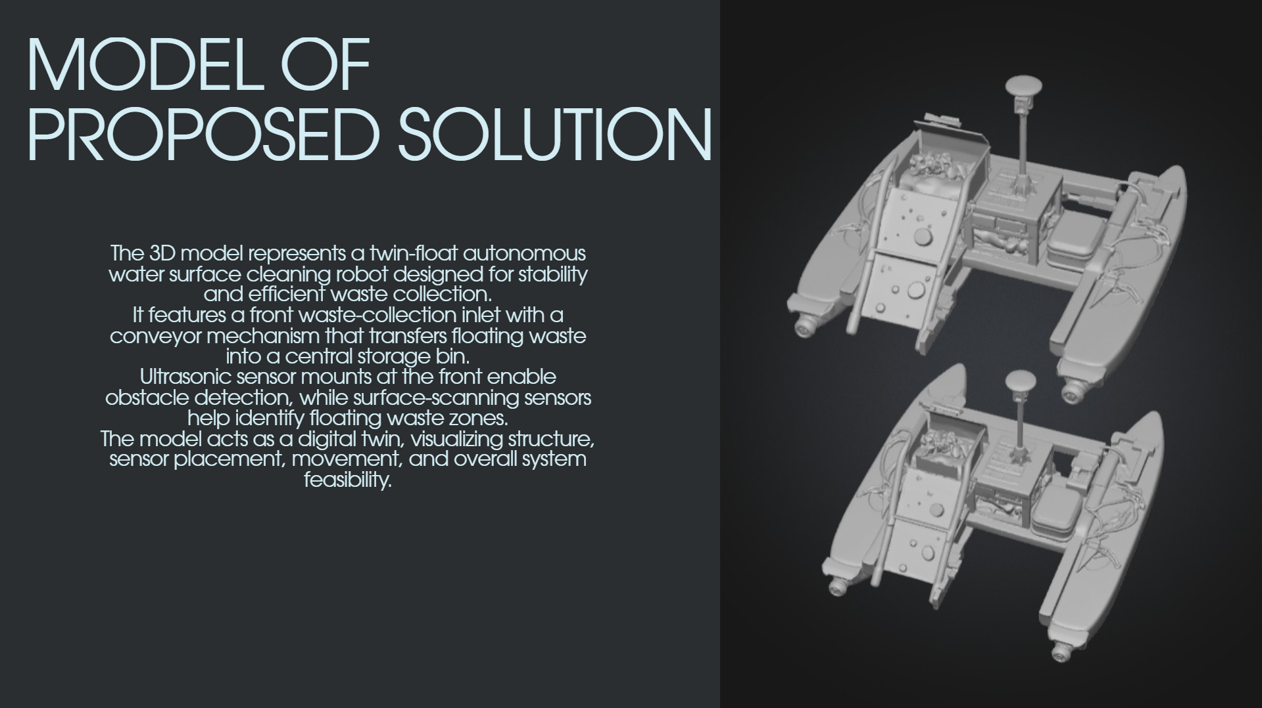

Slide 7
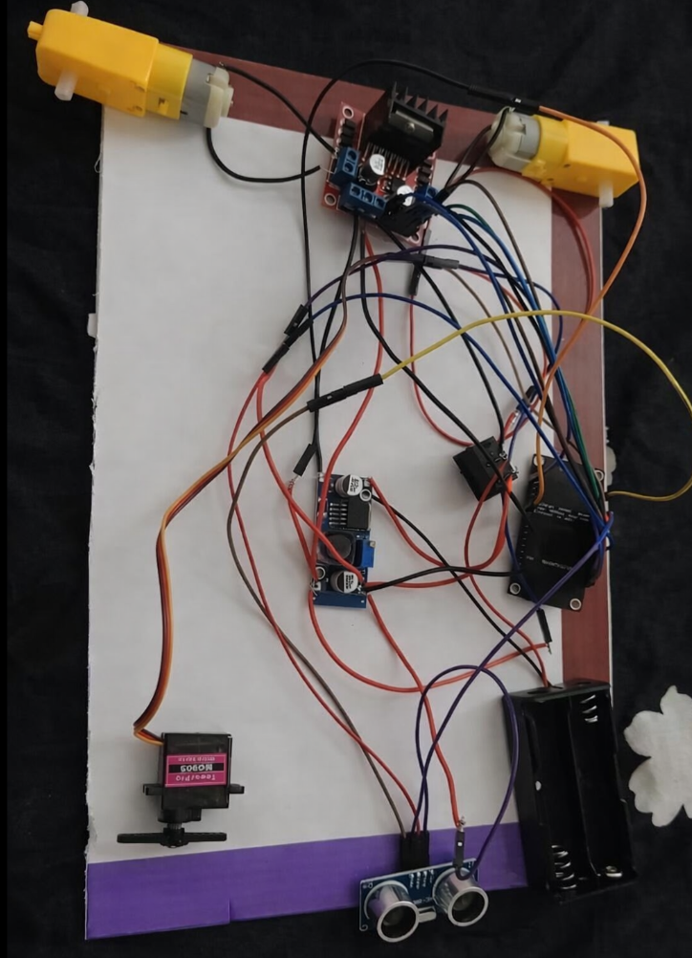
PROTOTYPE
The current working model represents a functional implementation of the proposed prototype. It’s built on a lightweight foam-board base and two BO double-shaft DC motors mounted on either side enable propulsion and steering on the water surface through differential speed control. An ESP8266 microcontroller acts as the central control unit, interfaced with an L298N motor driver to control the motors. Power is supplied by lithium-ion batteries and regulated using a DC buck converter to ensure stable operation of all electronic components. A servo motor mounted at the front operates the waste collection gate, allowing collected debris to be stored onboard. An ultrasonic sensor is positioned at the front to enable obstacle detection for autonomous navigation and to collect waste when detected. The prototype demonstrates a low-cost and scalable approach to automated water surface cleaning while retaining the core working principles such as autonomous movement, waste collection, and obstacle sensing. The present model successfully demonstrates the feasibility and operation of the proposed system.

Slide 8
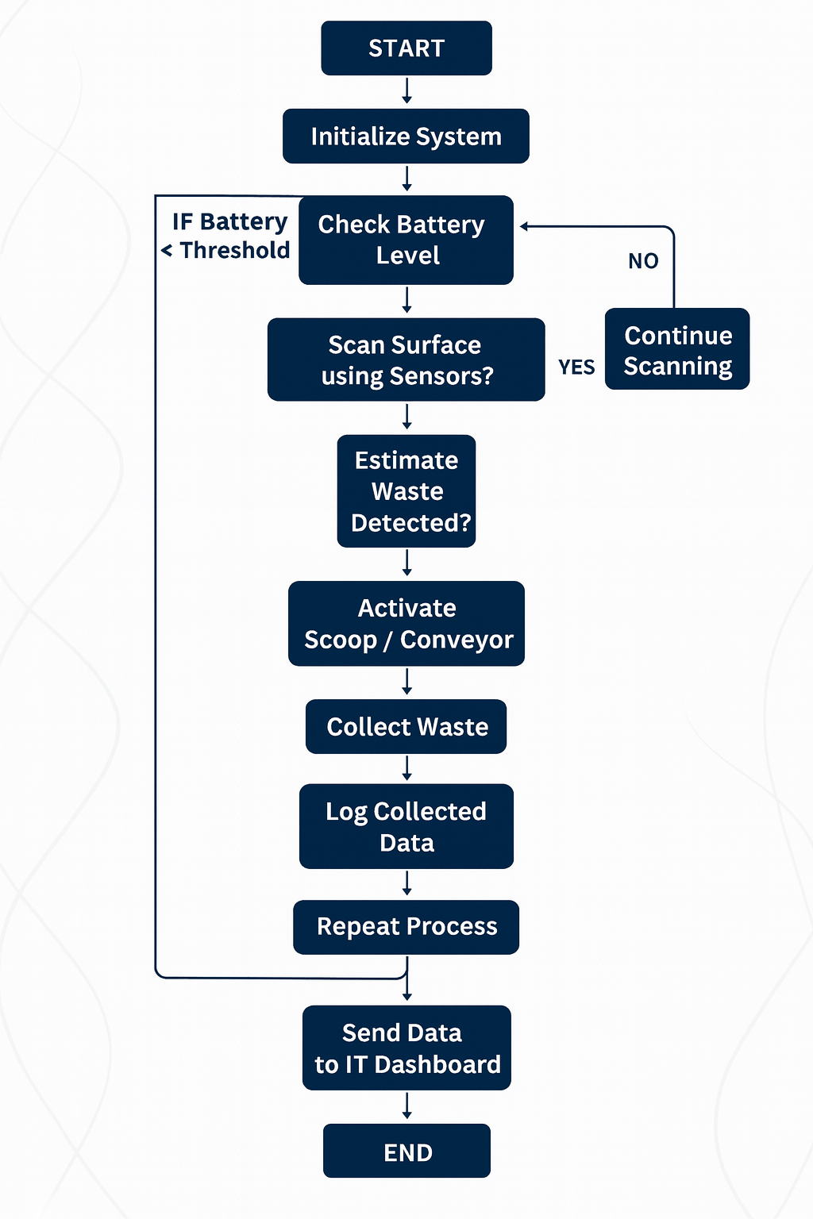
PROPOSED SOLUTION & WORKING

Slide 9
FEATURES & TECH STACK
KEY FEATURES:
Adaptive navigation based on waste density
Autonomous obstacle avoidance
Modular waste collection mechanism
Real-time data logging
Remote monitoring dashboard
Low-power optimized operation
TECH STACK:
Hardware:
Arduino / ESP32
Ultrasonic Sensors
DC Motors + Motor Driver
Battery + Power Management
Conveyor / Scoop Mechanism
Software:
Fusion 360 – Mechanical design & digital twin
Arduino IDE – Control logic
Tinkercad – Logic simulation
IoT Platform (ThingSpeak / Blynk)
Draw.io – Workflow & system diagrams

Slide 10
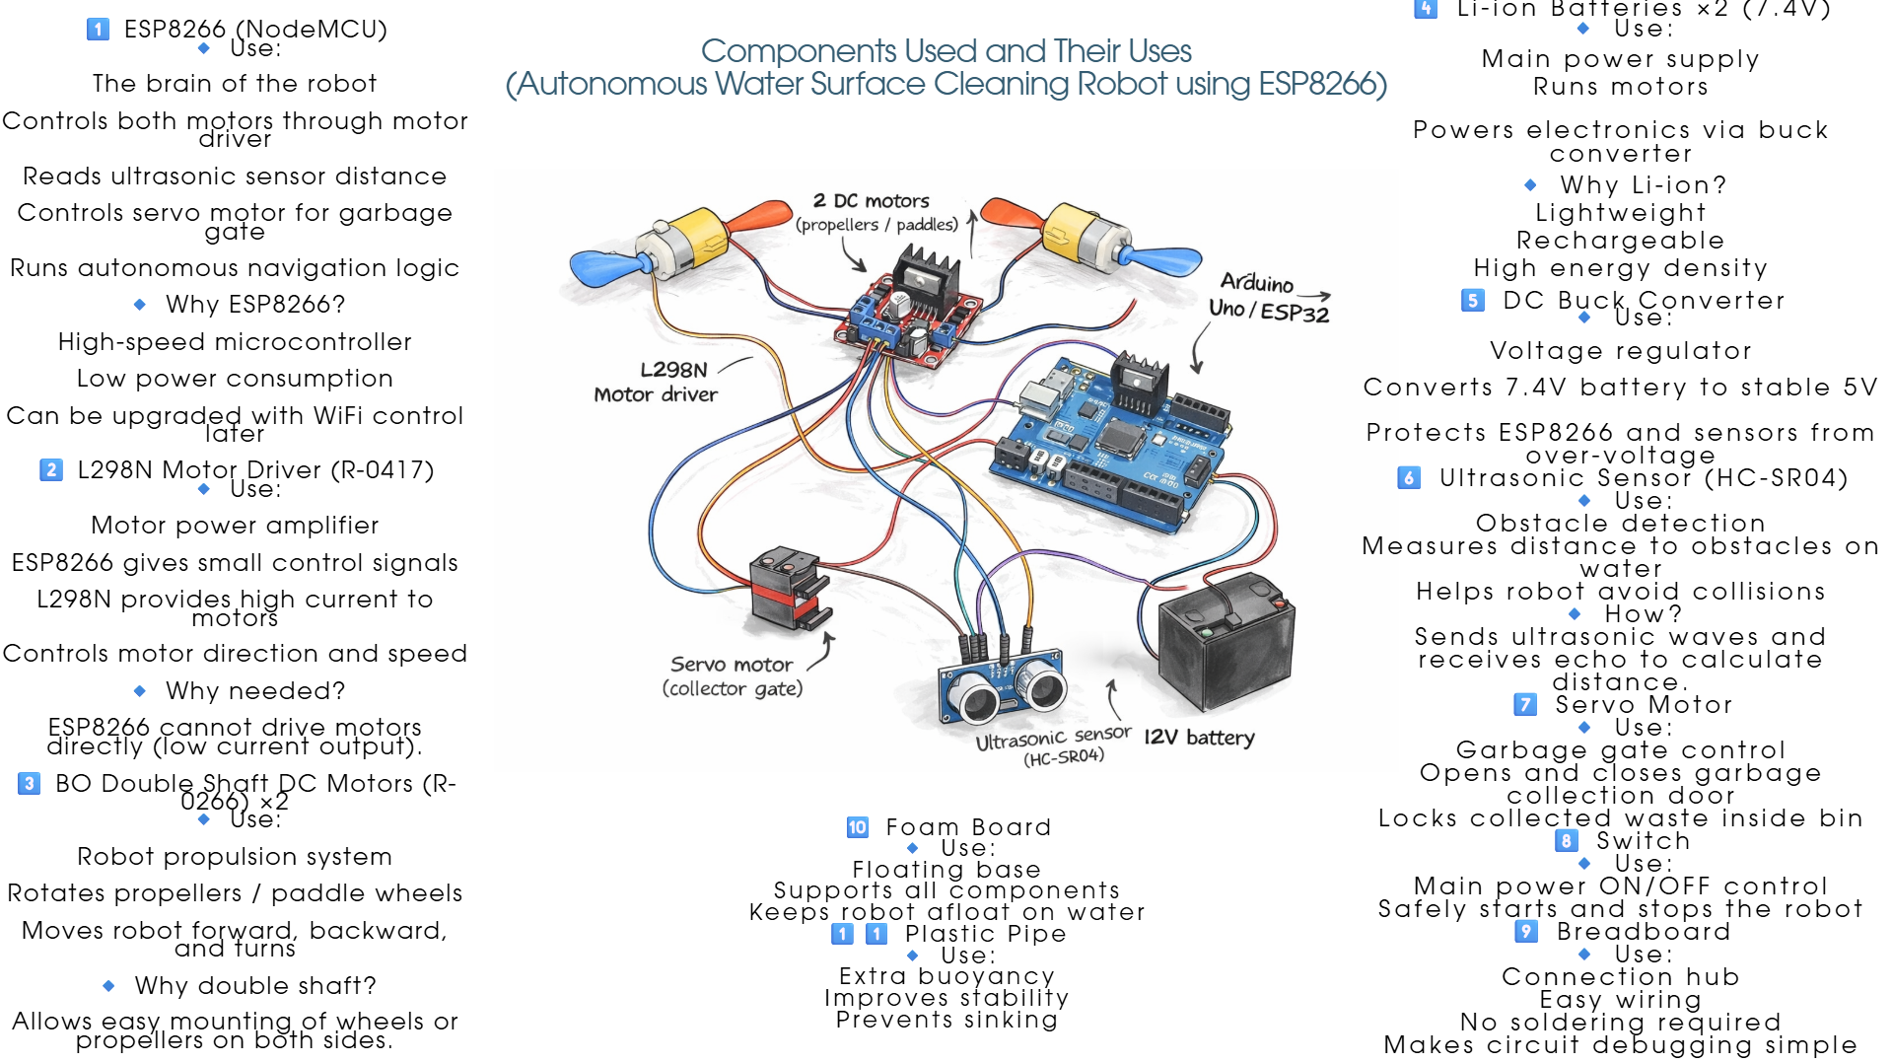

Slide 11
Novelty and USPs
Novelty:
Adaptive cleaning strategy instead of static paths
Waste-density-based decision making
Digital Twin driven design validation
Pollution data generation, not just waste removal
UNIQUE SELLING POINTS (USPs):
Higher cleaning efficiency per mission
Reduced energy consumption
Scalable for lakes, reservoirs, and harbors
Actionable environmental data for authorities
Our robot cleans AND informs.

Slide 12

SDGs ADDRESSED
Enhancing Ecosystems and Public Health
SDG 6 – Clean Water and Sanitation
Reduces floating waste and surface pollutants.
SDG 11 – Sustainable Cities and Communities
Improves urban water bodies and public hygiene.
SDG 13 – Climate Action
Prevents plastic and waste from entering marine ecosystems.
SDG 14 – Life Below Water
Protects aquatic life from surface-level pollution.

Slide 13
THANK YOU!
Team: Sky Forge
College: VIT Vellore

